Slide 1
Benchmarking text to 3D pipelines against novel pipeline.
Group 10.
Mehrab Mehdi Islam, Michael Miller, Michael Ishak, Lam Nguyen, Robinson Vasquez Ferrer
Notes:
Mehrab Mehdi Islam, Michael Miller, Michael Ishak, Lam Nguyen, Robinson Vasquez Ferrer

Slide 2
CONTENTS
1 Introduction
2 Related Works
3 Methods
4 Pipeline
5 Dataset
6 Conclusion
7 References

Slide 3
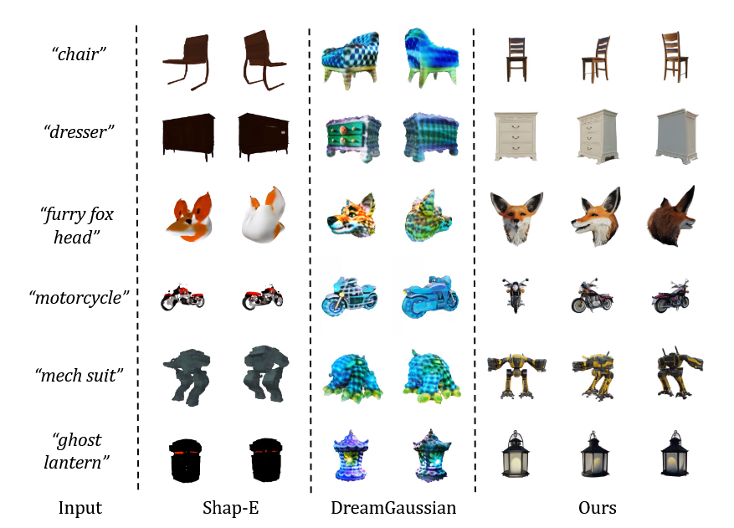
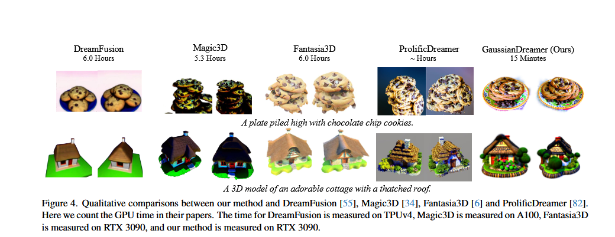
INTRODUCTION
Creating 3d models from text is expensive and tough.
Gaussian Splatting approaches a solution over NeRF!
AI GSplat generation from text is still expensive and low-density.
LGM
TOP: LGM paper BOTTOM: GaussianDreamer paper
Notes:
Creating 3d models from text is expensive and tough.
Gaussian Splatting is a reviving CV concept with great benefits of real-time rendering and compact representations of topologies.
Generation of splats from real-world and AI-generated images has seen much improvement since 2020
but
AI GSplat generation from text is still expensive and low-density.

Slide 4
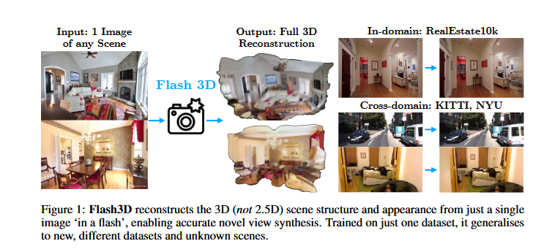
MOTIVATION
Flash3D – single-image to GSplat
Speedy-Splat: Fast 3D Gaussian Splatting with Sparse Pixels and Sparse Primitives
Splatt3R: Zero-shot Gaussian Splatting from Uncalibrated Image Pairs
DeepFloyd – Low-cost Diffusion Model
ControlNet – Multi-view Synthesis
Source: Flash3D paper
Notes:
We are motivated by things like Flash3D, Speedy-SPlat, and Splatt3R to generate 2d images and turn them into GSplats for cheap!

Slide 5
METHODS
Text prompt
Diffusion Model
Multi View Synthesizer
Gaussian Splat Model
Provide a simple prompt such as “chair”
Diffusion model generates images of the same chair
We use a Multi View Synthesizer to create multiple views of the same image.
Using the gaussian splat model a 3D reconstruction of the image is created

Slide 6
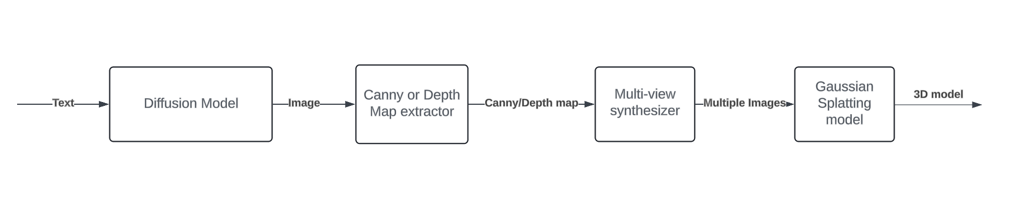

PIPELINE

Slide 7
Model to Benchmark Against
GaussianDreamer
LGM (Large Multi-View Gaussian Model)
Magic3D

Slide 8
DATASETS
Objaverse-XL
3D data in glb format. 10 Million+ 3D models with text annotations
Text2Shape
text annotated 3D objects
CO3D
~1.5 million frames from videos. Point Cloud representations and known camera positions
ScanNet
Reconstructed surface mesh files. ~2.5 million views with Camera parameters.
Multi-View Imagenet
~6.5 million frames. Multi-view images from one object. Camera parameters and Point Cloud annotations

Slide 9
REFERENCES
LGM: Large Multi-View Gaussian Model for High-Resolution 3D Content Creation, Tang et al, 2024. https://arxiv.org/pdf/2402.05054
GaussianDreamer: Fast Generation from Text to 3D Gaussians by Bridging 2D and 3D Diffusion Models, Yi et al, 2024. https://arxiv.org/pdf/2310.08529
Flash3D: Feed-Forward Generalisable 3D Scene Reconstruction from a Single Image. Szymanowicz et al, 2024. https://arxiv.org/pdf/2406.04343v1
Speedy-Splat: Fast 3D Gaussian Splatting with
Sparse Pixels and Sparse Primitives. Hanson et al, 2024. https://arxiv.org/pdf/2412.00578v1
Splatt3R: Zero-shot Gaussian Splatting from Uncalibrated Image Pairs, Smart et al 2024. https://arxiv.org/pdf/2408.13912
Adding Conditional Control to Text-to-Image Diffusion Models, Zhang et al 2023. https://arxiv.org/pdf/2302.05543
DeepFloyd IF, DeepFloyd Lab at StabilityAI. https://github.com/deep-floyd/IF

